Slide 1
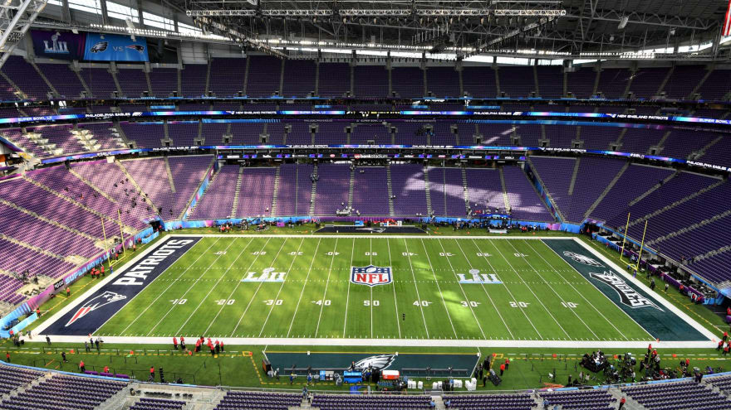
Analysis of Injury Risk for NFL Players
Group 3

Slide 2
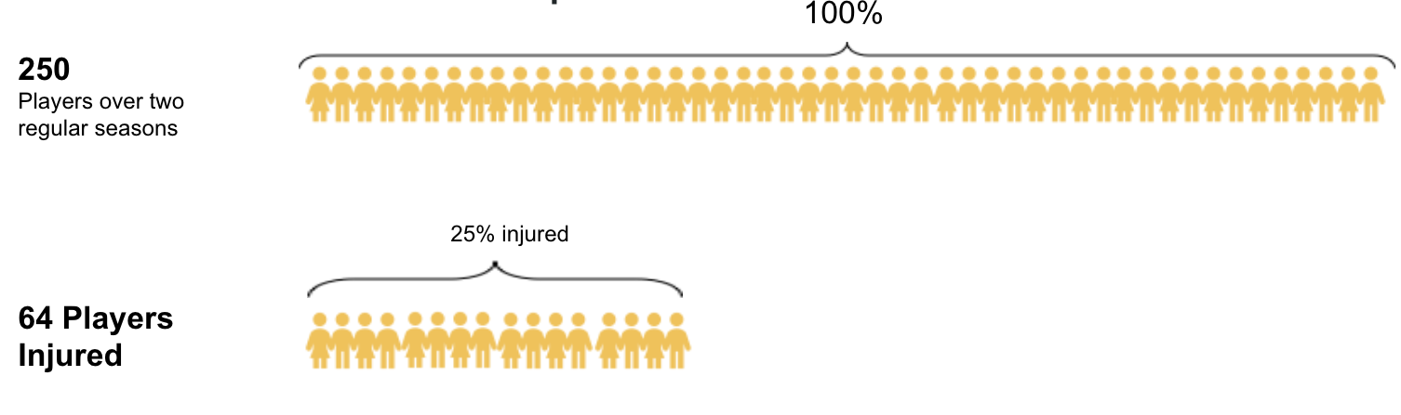
DATA
Injury Record
Non-contact lower limb injuries information
Play File
Player-play level data
Roster position,stadium type, field type, weather
Player Track
Player position, speed & orientation recorded 10 times/sec
Movement Pattern
Notes:
Injury Record: The injury record file contains information on 105 lower-limb injuries that occurred during regular season games over the two seasons.
Play list: The playlist file contains the details for the over 260 thousand player-plays that makeup the dataset. Details about the game and play include the player’s assigned roster position, stadium type, field type, weather, play type and so on.
Player Track Data has player level data that describes the location, orientation, speed and direction of each player during a play recorded at 10 Hz( i.e 10 observations recorded per second.)

Slide 3
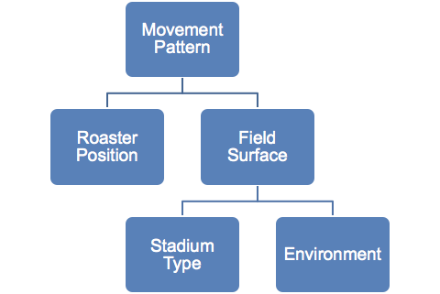
What get athletes injured?
We are trying to find the relationship between the injury tracks and the features of each play/track.
Influential Features:
Movement patterns
Speed
Directional Changes
Acceleration/Deceleration
Distance
Field Surface (Synthetic/Natural)
Stadium Type
Environment
Weather
Temperature
Roaster Position
Notes:
So,,
We are trying to analyze (National Football League)NFL non-contact lower-limb injury data over 2 regular seasons, and to identify different player movements on different field surfaces, weather, positions and etc that may influence the risk of injury.

Slide 4
One Track Animation (Injured)
Notes:
Instead of one single player, we take one single track of player movements as the basic unit. Because ev changes and the player changes his/her movement pattern in each game.
Here We display one example of an injured player’s track. We locate the instant location(change by 10hz) of this player on the left-hand-side, while on the right hand-side, we have direction, acc, speed for each time break.

Slide 5
Data Processing
Data Processing
Movement Pattern: for each track, calculate
a. mean/var of speed
b. mean/var of |Δ direction|
c. mean of |acceleration/deceleration|
d. distance
Notes:
(((The athlete's presentation following injury includes reporting of a contact or noncontact acceleration or deceleration twisting injury to the knee, a 'pop' or the sensation of the joint 'coming apart', haemarthrosis, a positive Lachman test, loss of extension, and a positive pivot shift test.)))

Slide 6
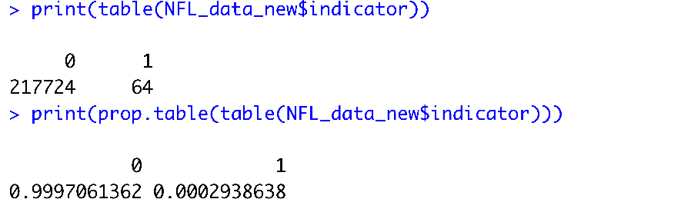
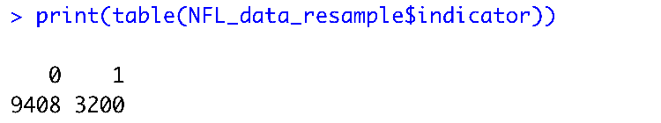
(Cont’d)
Data Processing
2. Resample
Original: Super Imbalanced!
0: non-injury track
1: injury track
b. Resampled: Proportional to injured player percentage (SMOTE)
Notes:
Data processing: (SMOTE!!!: Synthetic Minority Oversampling Technique) resample
--biased predictors
--misleading accuracy
Injury 1 track/game
Noninjury 1 track/game
Non vs in 3:2 7000 noninjury
Unique game 5681

Slide 7
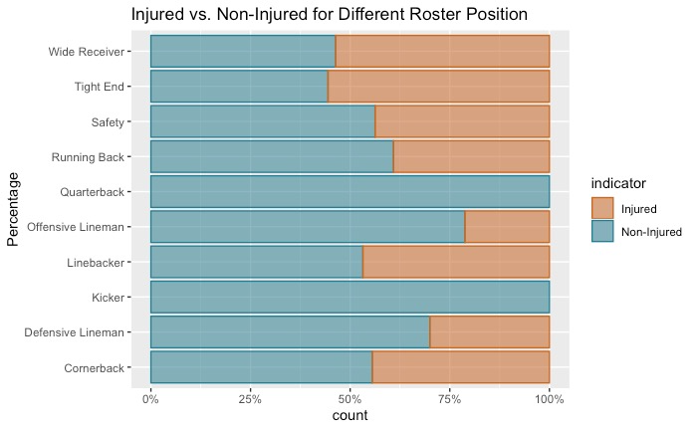
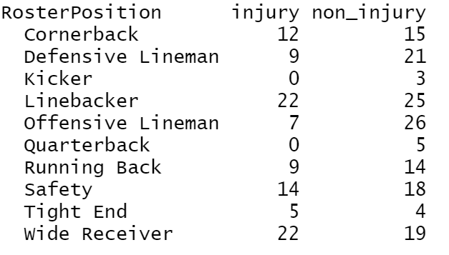
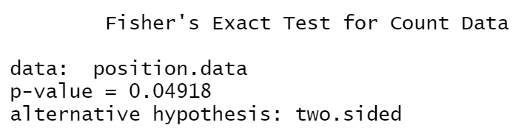
Roaster Position
Roaster Position
Association b/w roaster position and injury cases
Notes:
From the stackedbar plot, we propose there are association between And the later fisher’s …… validate/proved our hypothesis.

Slide 8
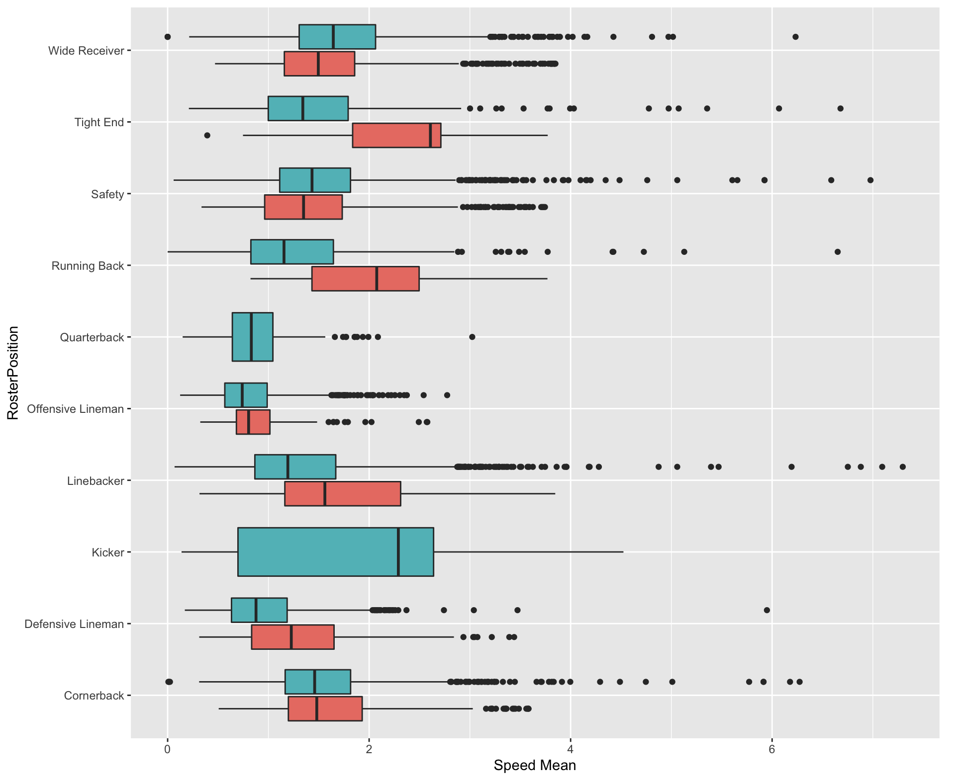
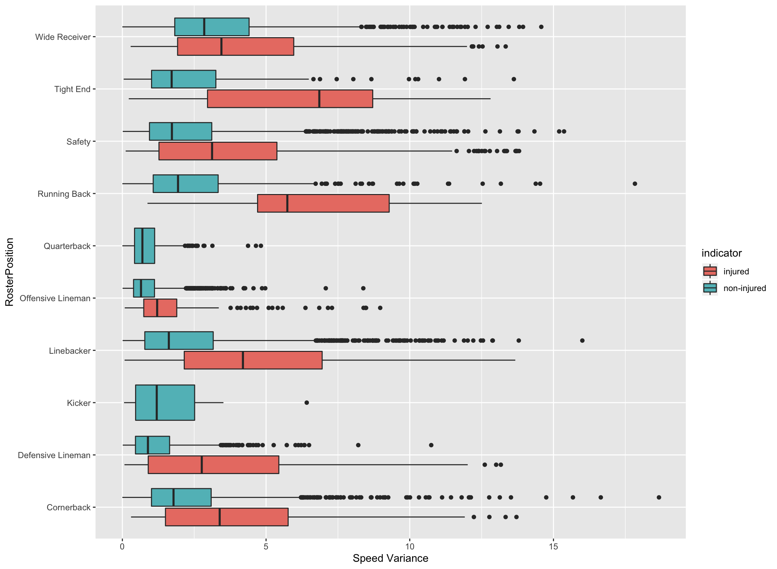
Roaster Position
Roaster Position + Speed mean,variance
Notes:
Eda: I'll spare you from going through all the exploration and visualization we did for this project. Instead, we'll show a couple relevant charts and numbers that inspired our risk of injury findings.
So we studied movement patterns of injury/noninjury tracks for each roster position
You can see from these plots, tight ends, running backs and linebackers tend to have larger average speed and greater deviance during their injured tracks than non-injured tracks.

Slide 9
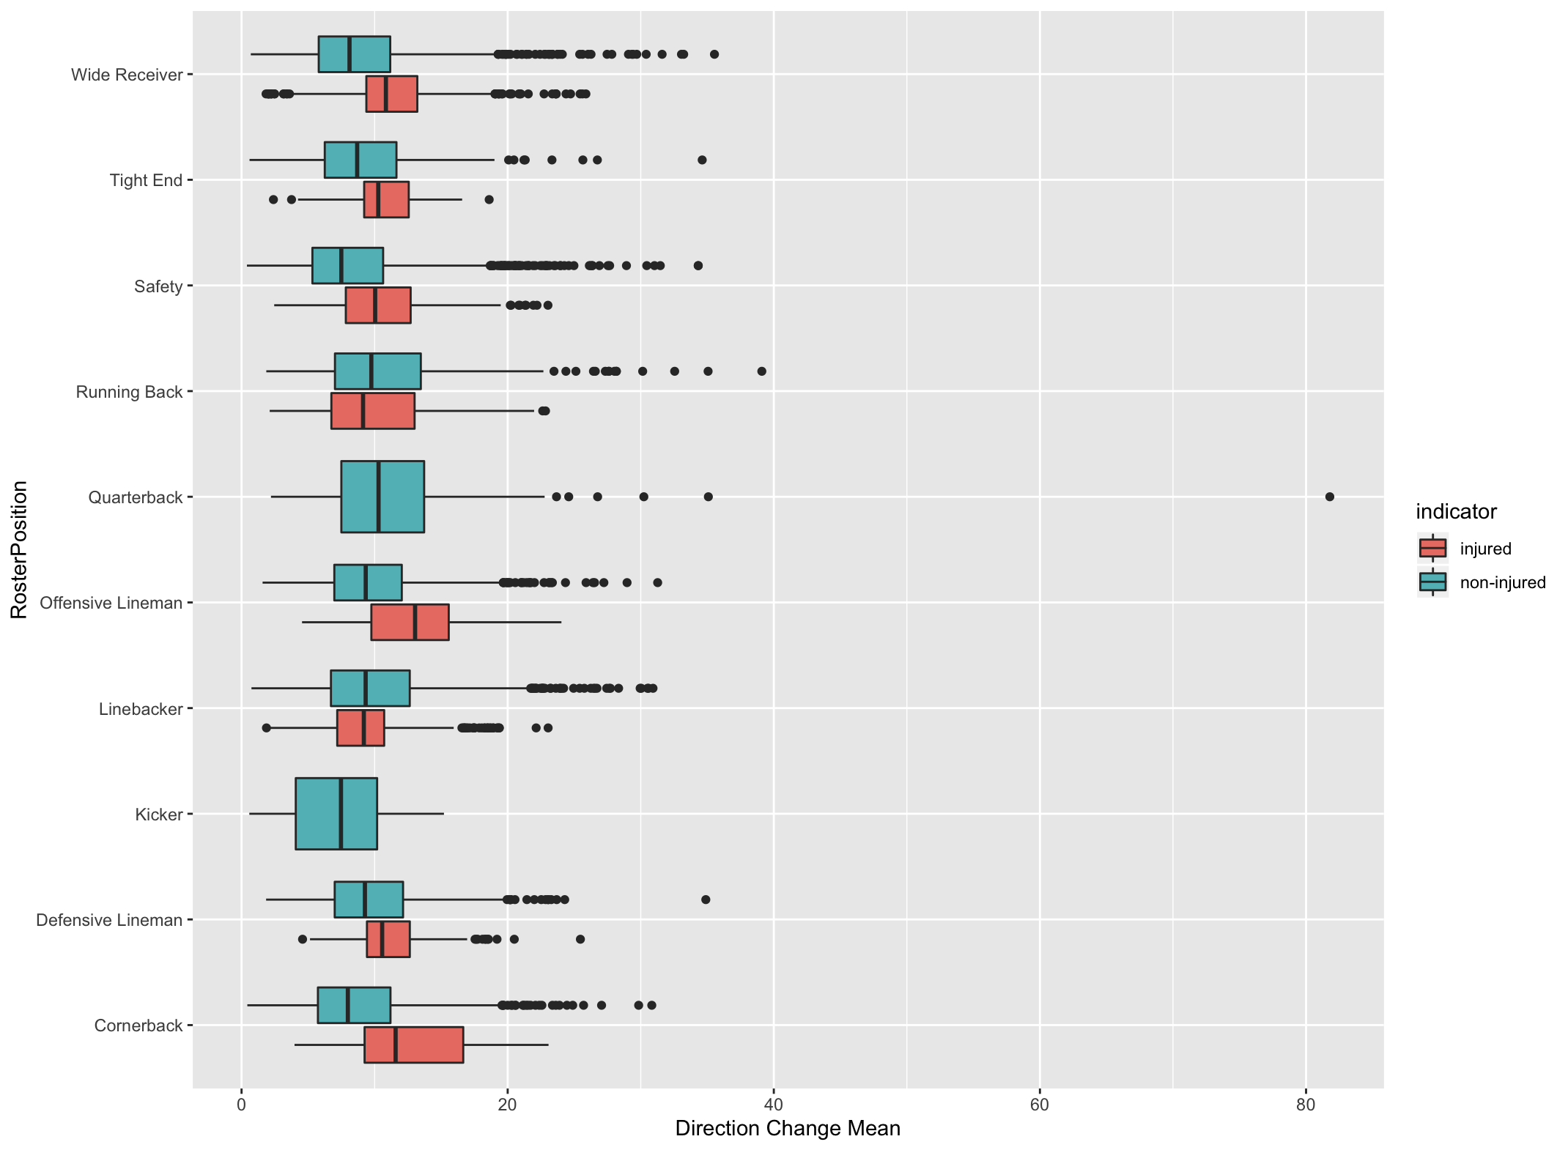
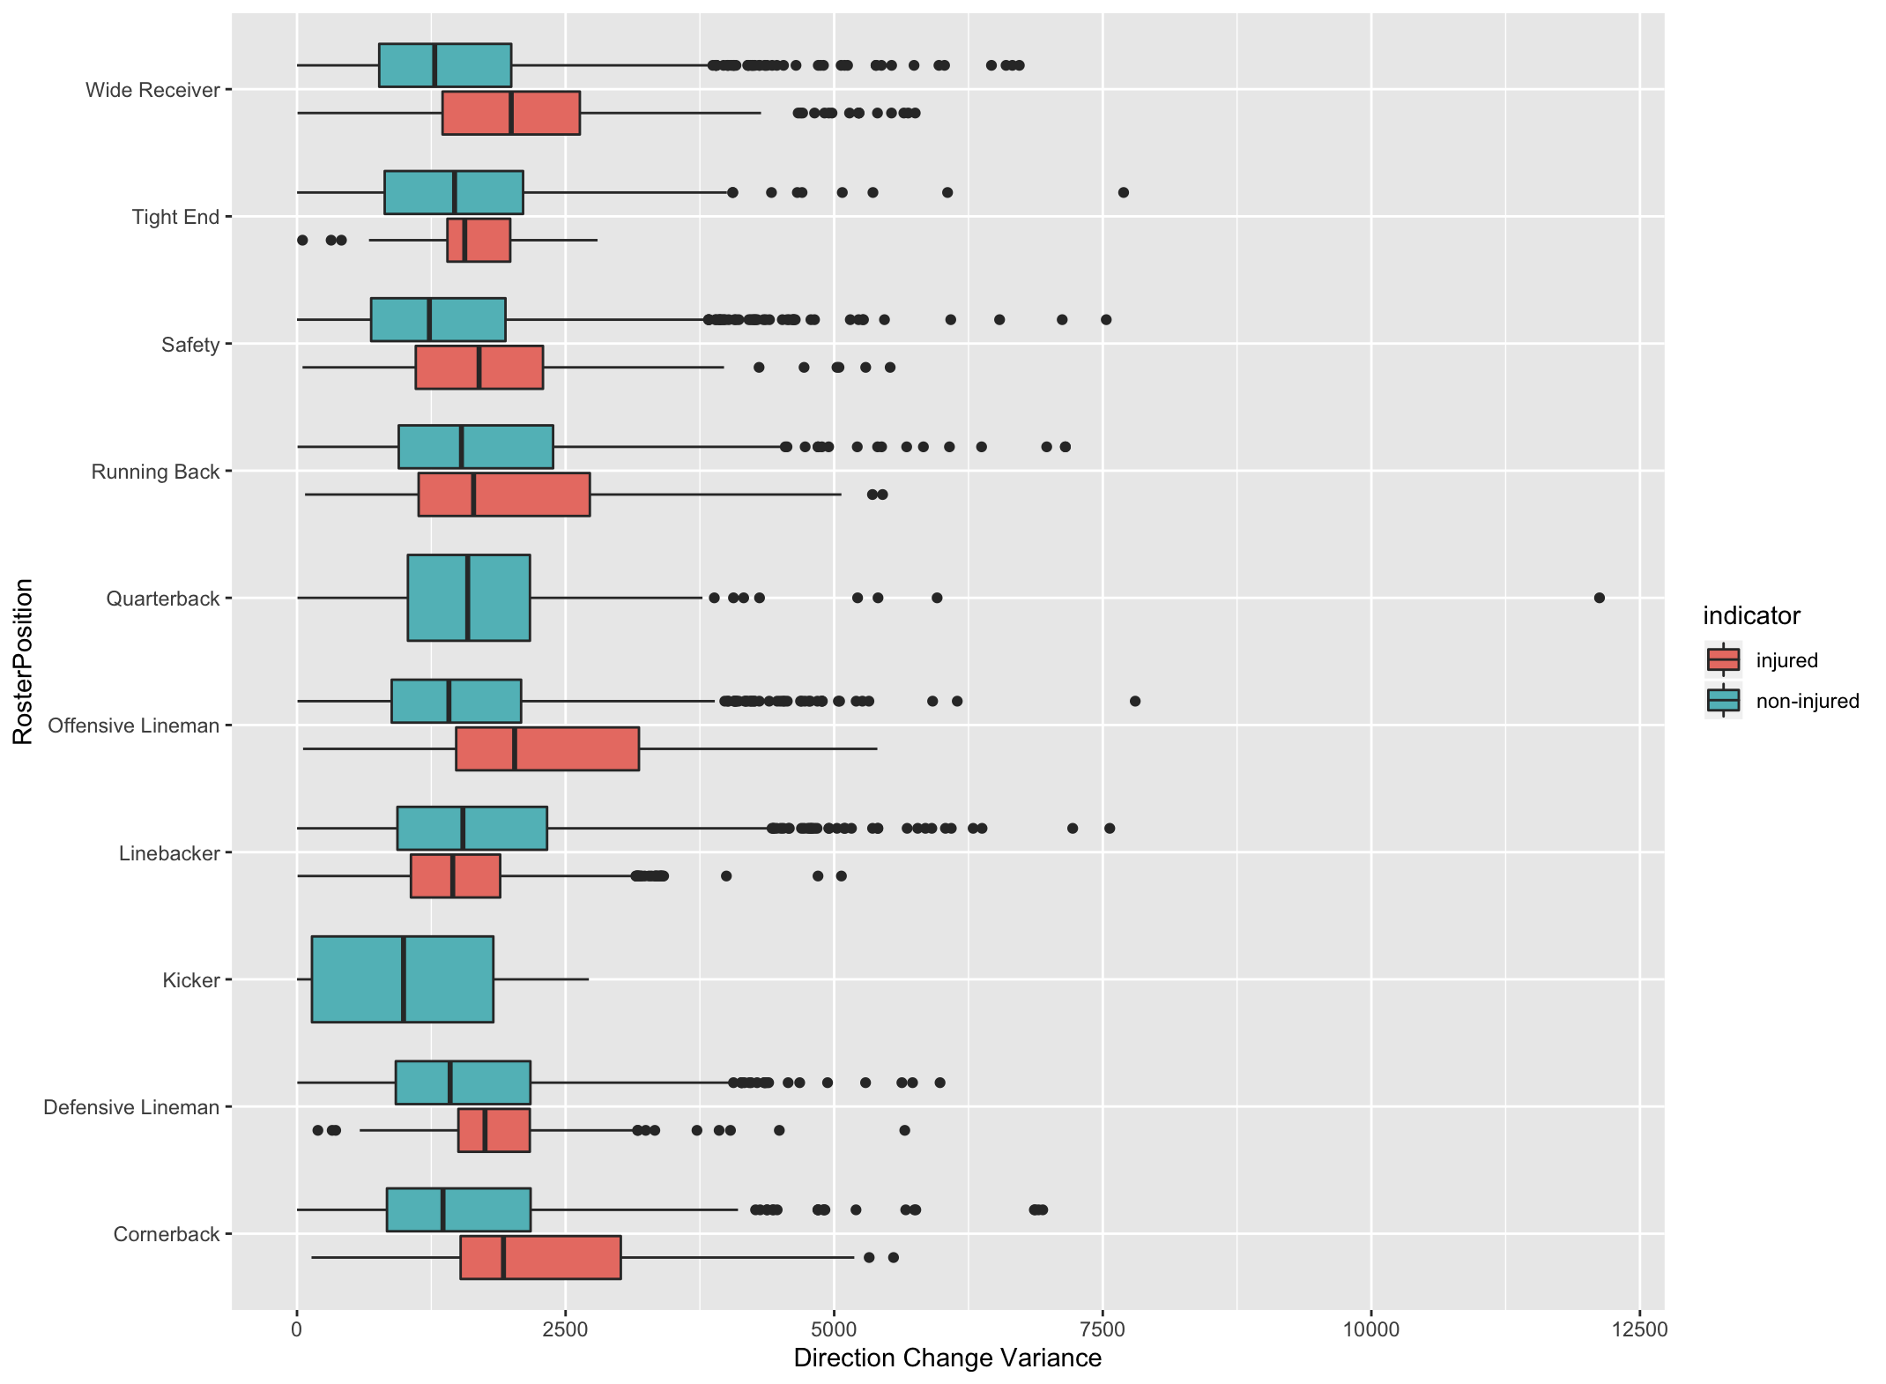
Roaster Position
b. Roaster Position+ |ΔDirection| mean,variance
Notes:
Similar patterns were shown for abs angle change of player motion.

Slide 10
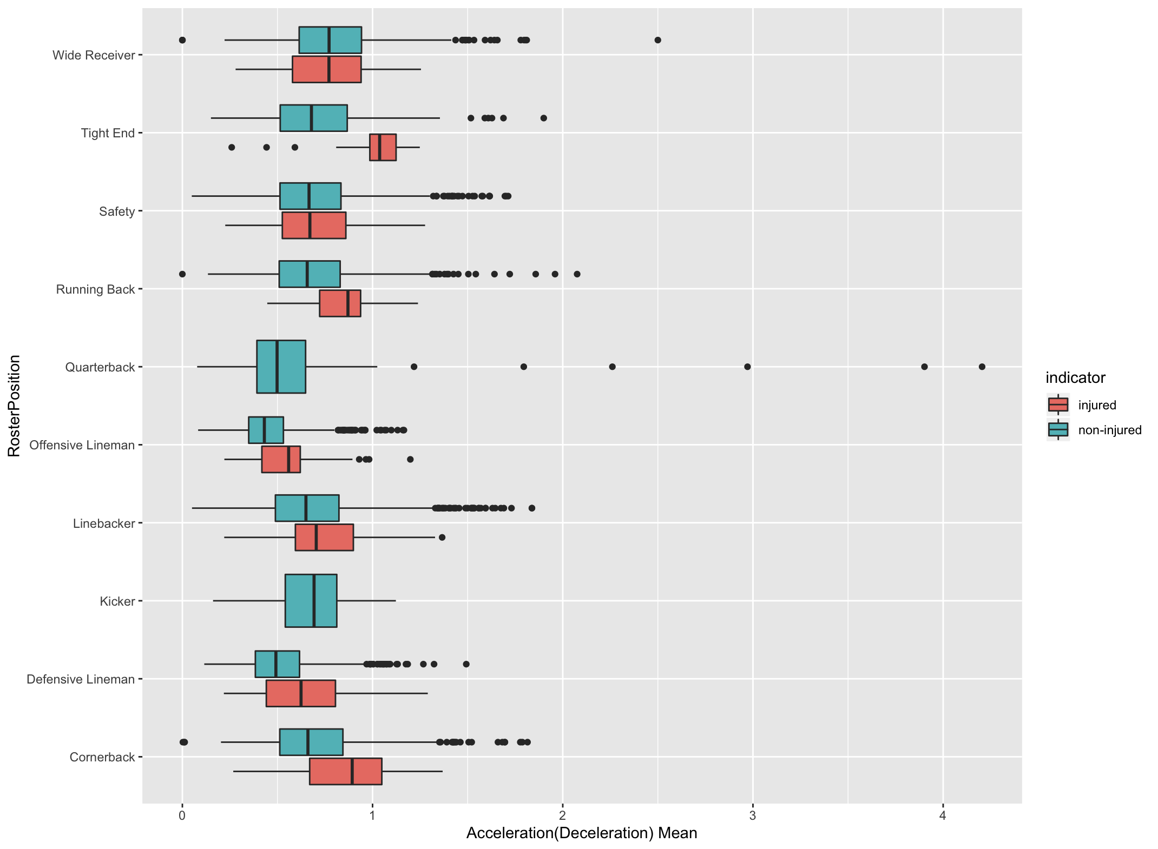

c. Roaster Position + |ACC/DEC|
Roaster Position
Notes:
Telling from the roaster position + |acc/dec| plot, we noticed that players in their injured tracks were more likely to acc/dec suddenly

Slide 11
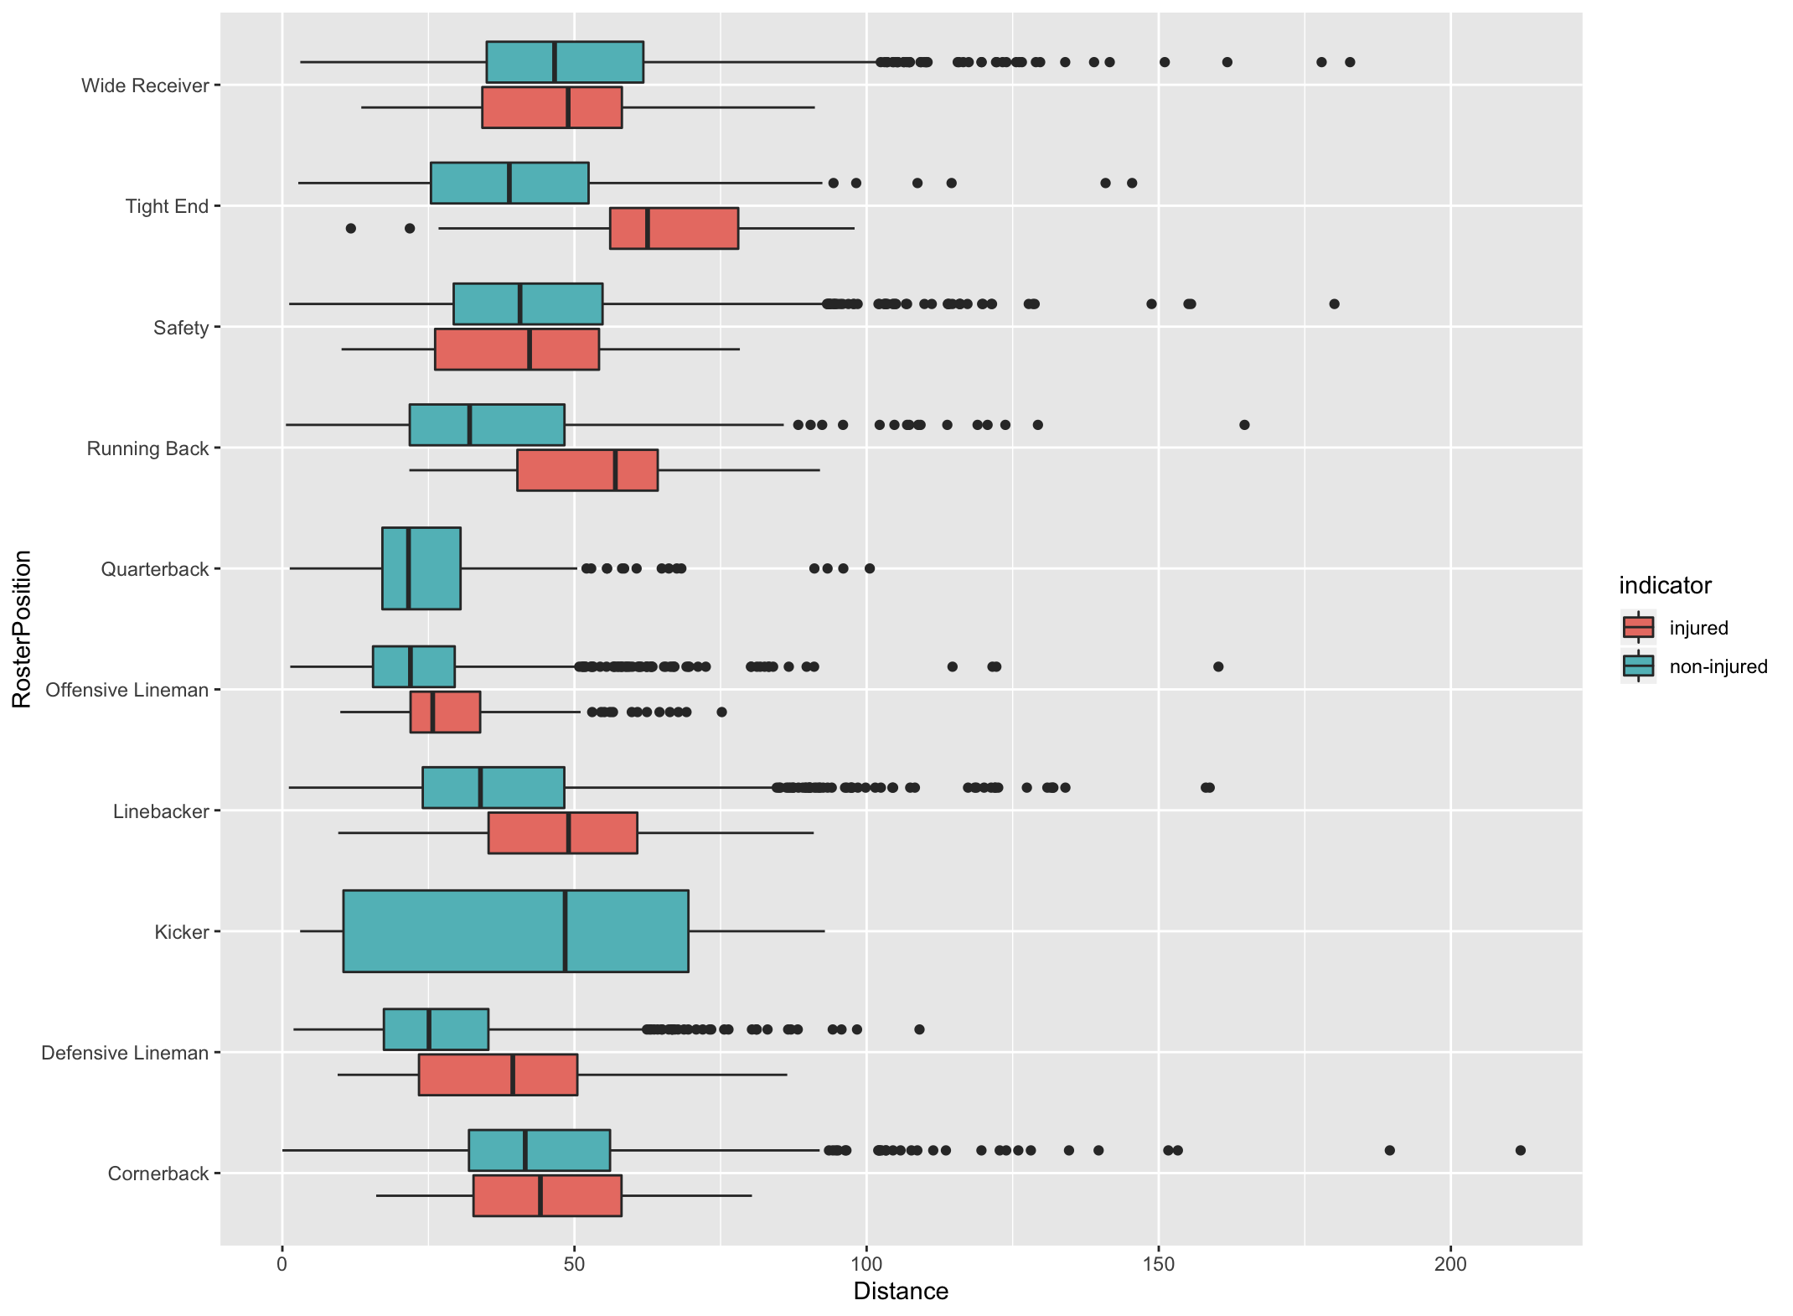
Roaster Position
d. Roaster Position + Distance
Notes:
For total distance of one track, majority positions’ players incline to run longer distance during their injured tracks.

Slide 12
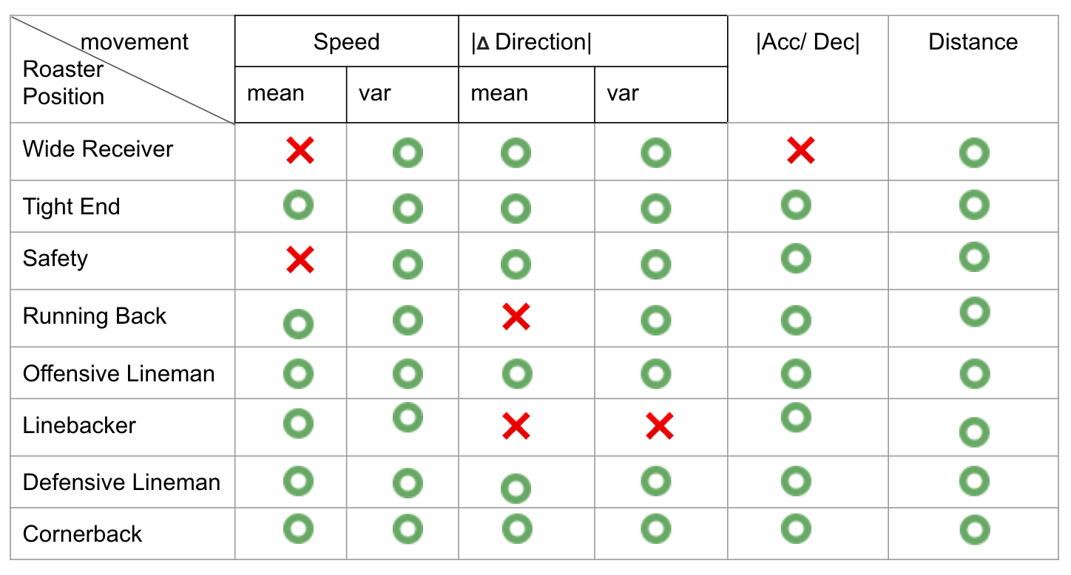
Summary
Roaster Position
Notes:
From our previous discussions, this player movement matrix can capture significant diffs b/w injury tracks and noninjury tracks across majority of roaster positions

Slide 13
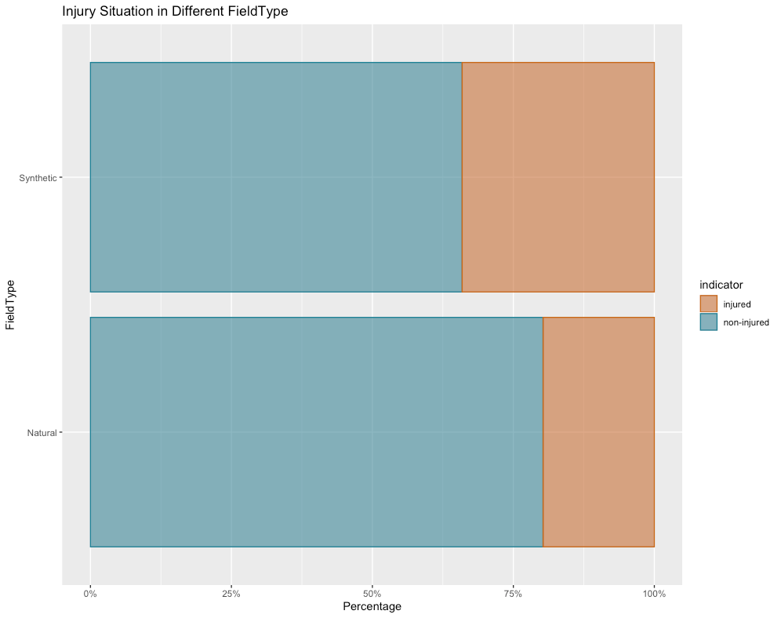

t
Field Surface
Number of Tracks | Synthetic turf | Natural turf
Injured | 1692 | 1508
Non-injured | 3272 | 6136
Association b/w field type and injury cases
Notes:
Another important feature corr w/ football injuries is field surface(synthetic turf, natural turf)
chi-->assco

Slide 14
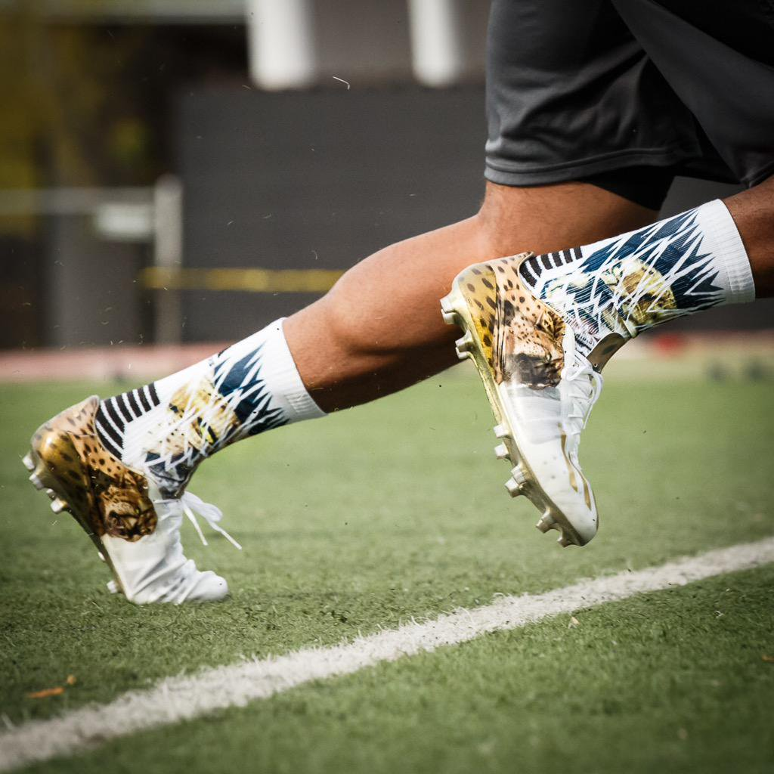
Field Surface
Synthetic turf surfaces do not release cleats as readily as natural turf.
Notes:
Recent investigations of lower limb injuries among football athletes have indicated significantly higher injury rates on synthetic turf compared with natural turf because that synthetic turf surfaces do not release cleats as readily as natural turf and may contribute to the incidence of non-contact lower limb injuries (Kent et al., 2015).

Slide 15

More …
Field Surface + Stadium Type
Number of Tracks | Synthetic turf + Not affected | Synthetic turf + affected | Natural turf + not affected | Natural turf + affected
Injured | 583 | 1109 | 469 | 1039
Non-injured | 1295 | 1977 | 122 | 6014
Affected: Outdoor, dome open, indoor open
Not Affected: dome closed, indoor closed
Notes:
Furthermore, we try to characterize any differences in player movement between the playing surfaces and stadium type that may influence player movement and the risk of injury.
Here, the affected stadium types those that would affected by the weather.

Slide 16
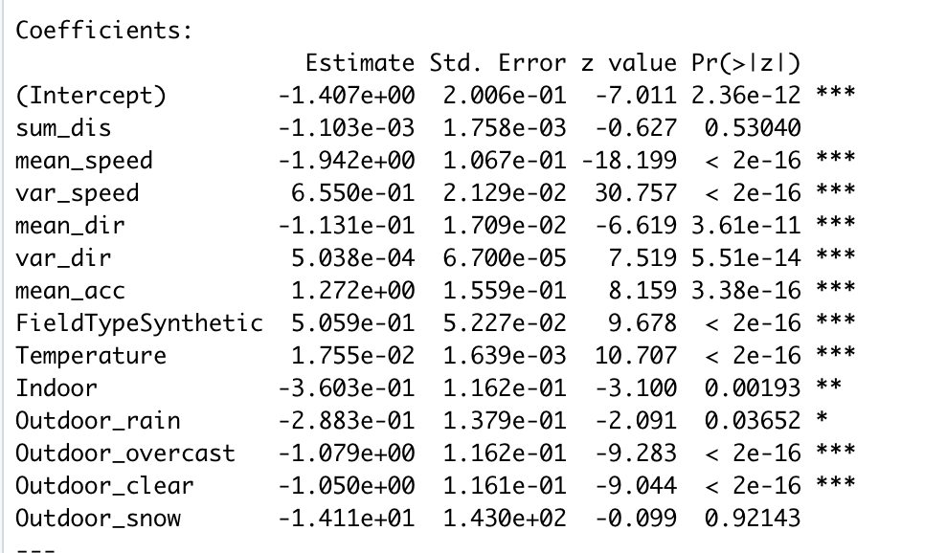
Movement Pattern + Field Surface + Environment
More …
e^(1.27) >1 : odds ratio of injury for “higher acc” over “lower acc”
“Lower acc” is safer
Notes:
Furthermore, we try to characterize any differences in player movement between the playing surfaces and stadium type that may influence player movement and the risk of injury.

Slide 17
Movement Pattern + Field Surface + Environment
More …
e^(1.27) >1 : odds ratio of injury for “higher acc” over “lower acc”
“Lower acc” is safer
e^(0.506) >1 : odds ratio of injury for “Synthetic” over “Natural” field surface
“Natural” field is safer
Notes:
Furthermore, we try to characterize any differences in player movement between the playing surfaces and stadium type that may influence player movement and the risk of injury.

Slide 18
Movement Pattern + Field Surface + Environment
More …
e^(1.27) >1 : odds ratio of injury for “higher acc” over “lower acc”
“Lower acc” is safer
e^(0.506) >1 : odds ratio of injury for “Synthetic” over “Natural” field surface
“Natural” field is safer
e^(0.018) >1 : odds ratio of injury for “One degree temp higher” over “current temp”
“Wamer” is safer
Notes:
Furthermore, we try to characterize any differences in player movement between the playing surfaces and stadium type that may influence player movement and the risk of injury.

Slide 19
Movement Pattern + Field Surface + Environment
More …
All together, winter season...
--Players
→ sufficient warm-ups
→ avoid sudden acc/dec
--NFL
→ natural fields
Notes:
Furthermore, we try to characterize any differences in player movement between the playing surfaces and stadium type that may influence player movement and the risk of injury.

